Slide 1

Double ended queue; Circular queue, Priority Queue
Data Structure | ADT: Stack and Queue
Course: Data Structure | Chapter: ADT: Stack and Queue | Bachelor of Engineering
DISCOVER · LEARN · EMPOWER
Notes:
Welcome everyone to today's lecture on advanced queue structures. We will explore how Double Ended Queues, Circular Queues, and Priority Queues extend the basic linear queue concepts. These structures are essential for optimizing memory usage and handling complex data processing scenarios in real-world applications.

Slide 2
Course Outcomes
SLIDE 2 / 10
Course Outcome
CO | BT LEVEL | DESCRIPTION
CO1 | BT1 | Understand and apply basic data structures, algorithms, complexity analysis, ADTs, arrays and linked lists.
CO2 | BT2 | Apply and implement stacks and queues in problem-solving.
CO3 | BT3 | Analyse and apply searching, sorting, and hashing techniques.
CO4 | BT4 | Construct and apply tree structures and traversal techniques.
CO5 | BT5 | Represent and solve graph problems using DFS, BFS, and graph algorithms.
Chandigarh University
2 / 10
Notes:
Although our focus today is on queues, these outcomes remain relevant as queues are fundamental components in graph traversal algorithms like BFS. Understanding these structures helps you construct efficient tree and graph solutions later in the course. Please note that CO4 and CO5 are the specific outcomes mapped to this lecture's content.

Slide 3
Learning Objectives
SLIDE 3 / 10
Learning Outcomes
1
Analyze the operational differences between Double Ended Queues and standard queues.
2
Evaluate the memory efficiency benefits of implementing Circular Queues over linear ones.
3
Construct Priority Queue algorithms using heap data structures for optimal sorting.
4
Apply these advanced structures to solve real-time scheduling and memory management problems.
Chandigarh University
3 / 10
Notes:
By the end of this session, you will be able to analyze how DEQs allow insertion at both ends. You will evaluate why circular queues prevent memory wastage compared to linear implementations. We will also construct priority queue logic using heaps and apply these concepts to scheduling problems.

Slide 4
Lecture
SLIDE 4 / 10
Double Ended Queue (DEQ) Definition
IT SUPPORTS FOUR DISTINCT OPERATIONS
insert_front, insert_rear, delete_front, and delete_rear.
• A DEQ allows insertion and deletion operations at both the front and rear ends.
• This structure combines the functionalities of both stacks and standard queues into one.
• DEQs are ideal for scenarios requiring flexible data access from either end of the list.
• Memory usage remains O(n) similar to linear queues but with increased operational flexibility.
Chandigarh University
4 / 10
Notes:
Think of a DEQ as a two-way street where cars can enter and exit from either side. Unlike a standard queue which is a one-way street, a DEQ offers maximum flexibility. For example, in a browser history feature, you might need to add a new page at the end or remove the most recent page from the end.

Slide 5

Lecture
SLIDE 5 / 10
Circular Queue Implementation Logic
1
A circular queue connects the last position back to the first position logically.
2
It solves the wastage of empty spaces in linear queue implementations using modulo arithmetic.
3
The condition for a full queue is (rear + 1) % size equals front.
4
The condition for an empty queue is front equals rear.
5
This structure ensures constant time O(1) for both insertion and deletion operations.
Source: www.conceptdraw.com
Chandigarh University
5 / 10
Notes:
In a linear queue, once the rear hits the end, the queue appears full even if space exists at the beginning. A circular queue wraps around using the modulo operator to reuse that space. Imagine a round table where the last person passes the ball to the first person to continue the game without stopping.

Slide 6
Lecture
SLIDE 6 / 10
Priority Queue Concept and Usage
1
Elements in a priority queue are processed based on their assigned priority value.
2
Higher priority elements are dequeued before lower priority elements regardless of arrival time.
3
This structure is critical for CPU scheduling and handling emergency medical cases.
4
It can be implemented using arrays, linked lists, or binary heaps for efficiency.
5
Binary heaps provide O(log n) time complexity for insertion and deletion operations.
Chandigarh University
6 / 10
Notes:
Consider a hospital emergency room where a patient with a heart attack is treated before someone with a minor cut, regardless of who arrived first. This is the core logic of a priority queue. In computer systems, this ensures that critical tasks like interrupt handling are processed immediately.

Slide 7
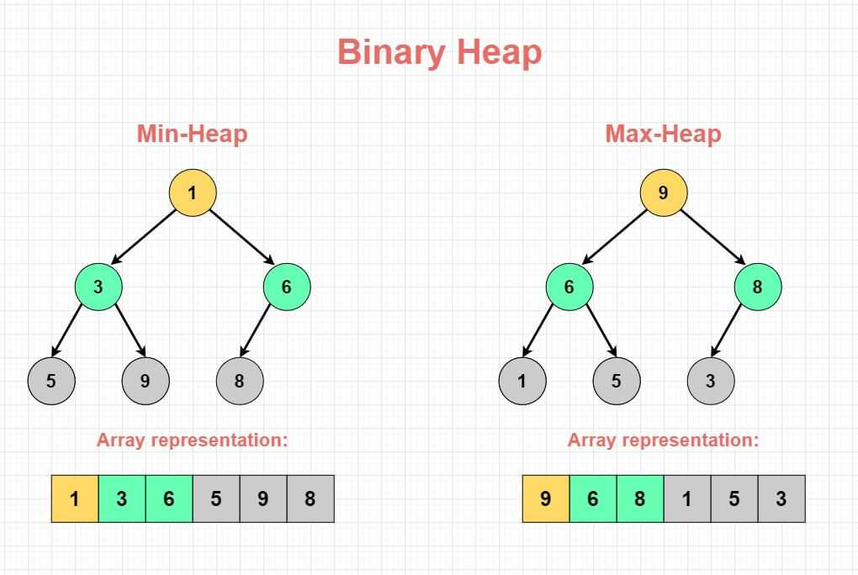
Priority Queue
SLIDE 7 / 10
Binary Heap Example
1
A max-heap ensures the root node always contains the highest priority element.
2
Insertion involves adding to the end and bubbling up to maintain heap property.
3
Deletion removes the root and replaces it with the last element, then bubbling down.
4
The heap property guarantees that parent nodes are always greater than or equal to children.
5
This structure allows efficient retrieval of the maximum element in constant time O(1).
Source: www.sahinarslan.tech
Chandigarh University
7 / 10
Notes:
Let's look at a max-heap where the root is the highest value. If we insert a new value, we place it at the bottom and swap it up until it is smaller than its parent. For instance, inserting 90 into a heap with root 80 requires swapping them to maintain the order.

Slide 8
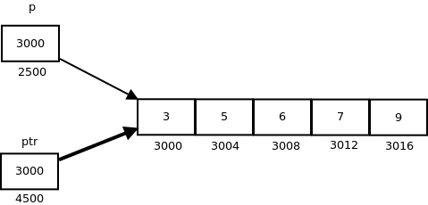
Numerical Example
SLIDE 8 / 10
Circular Queue
1
Consider a circular queue of size 5 with front at 0 and rear at 4.
2
Inserting a new element at rear 4 wraps around to index 0 using modulo 5.
3
The formula (rear + 1) % 5 calculates the next available position correctly.
4
If front is 0 and rear is 4, the queue is full and no insertion is possible.
5
This logic prevents overflow errors and maximizes the utilization of the allocated array.
Source: media.geeksforgeeks.org
Chandigarh University
8 / 10
Notes:
Let's calculate the next position. If rear is at index 4 in a size 5 array, the next position is (4 + 1) % 5, which equals 0. This demonstrates how the circular nature allows us to reuse the first slot. This is crucial for preventing false overflow conditions in fixed-size arrays.

Slide 9
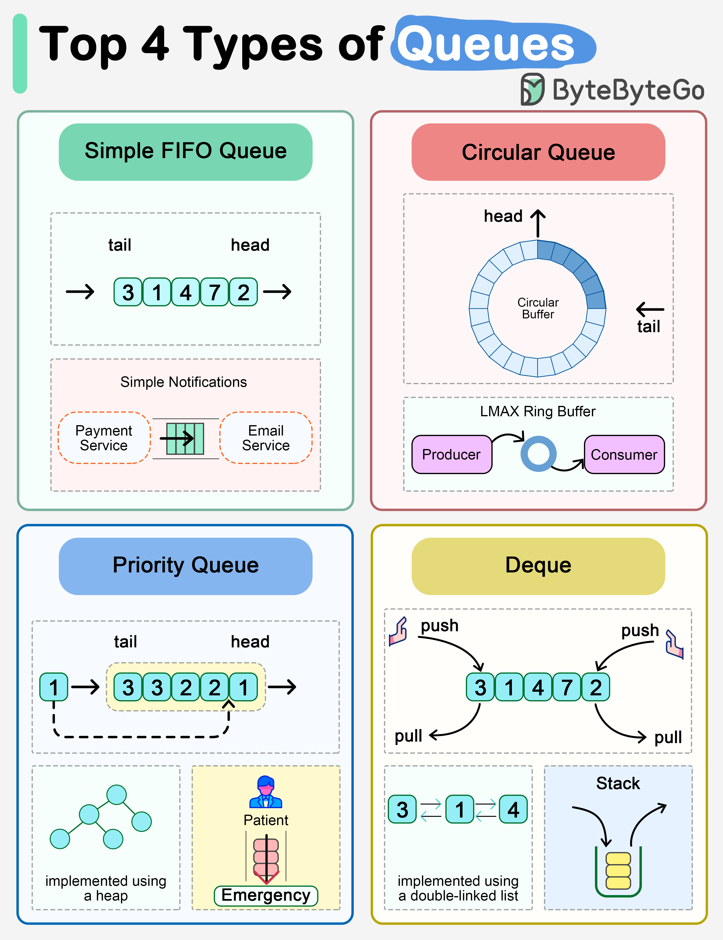
Lecture
SLIDE 9 / 10
Key Takeaways
1
Double Ended Queues allow operations at both ends for maximum flexibility.
2
Circular Queues eliminate memory wastage by wrapping around the array boundaries.
3
Priority Queues process elements based on importance rather than arrival order.
4
Binary Heaps are the optimal data structure for implementing efficient Priority Queues.
5
All three structures maintain O(1) or O(log n) time complexities for core operations.
Source: assets.bytebytego.com
Chandigarh University
9 / 10
Notes:
To summarize, remember that DEQs offer bidirectional access, circular queues optimize space, and priority queues manage order by importance. These structures are not just theoretical concepts but are used extensively in operating systems and network protocols. Mastering these will significantly improve your ability to design efficient algorithms.

Slide 10
Lecture
SLIDE 10 / 10
References
DATA STRUCTURES
A Pseudocode Approach with C — Gilberg, Forouzan
• Data Structures — Lipschutz
• Data Structure Using C — AK Sharma
• C and Data structure — P. S. Deshpandey
Chandigarh University
10 / 10
Notes:
For further reading, I recommend the texts by Gilberg and Forouzan for their pseudocode approach. Lipschutz provides excellent theoretical foundations, while AK Sharma and Deshpandey offer practical C implementations. Please refer to these books for additional problems and deeper insights into these data structures.

